Slide 1

Housing: price prediction
By Ashok Kumar Sharma

Slide 2
ACKNOWLEDGMENT
I would like to express my deep sense of gratitude to my SME (Subject Matter Expert) Mr. Shubham Yadav as well as Flip Robo Technologies who gave me the golden opportunity to do this data science project on Housing: Price Prediction, which also helped me in doing lots of research and I came to know about so many new things.
I am very much thankful to Dr. Deepika, Trainer (DataTrained), for their valuable guidance, keen interest and encouragement at various stages of my training period which eventually helped me a lot in doing this project.
I also acknowledge with thanks for suggestion and timely guidance, which I have received from my SME Mr. Shubham Yadav during this project, which immensely helped me in the evaluation of my ideas on the project.
Ashok Kumar Sharma

Slide 3
introduction
Business Problem Framing
Houses are one of the necessary need of each and every person around the globe and therefore housing and real estate market is one of the markets which is one of the major contributors in the world’s economy. It is a very large market and there are various companies working in the domain. Data science comes as a very important tool to solve problems in the domain to help the companies increase their overall revenue, profits, improving their marketing strategies and focusing on changing trends in house sales and purchases. Predictive modelling, Market mix modelling, recommendation systems are some of the machine learning techniques used for achieving the business goals for housing companies.

Slide 4
introduction
Conceptual Background of the Domain Problem
Housing, or more generally living spaces, refers to the construction and assigned usage of houses or buildings collectively, for the purpose of sheltering people. Housing is recognized as a social determinant of health. Lack of housing or poor-quality housing can negatively affect an individual's physical and mental health. Housing attributes that negatively affect physical health include dampness, mold, inadequate heating, and overcrowding. Mental health is also affected by inadequate heating, overcrowding, dampness, and mold, as well as lack of personal space.

Slide 5
introduction
Review of Literature
What is House Price Prediction?
House Price Predictions are beneficial for property investors to know the trend of housing prices in a certain location.

Slide 6
introduction
Motivation for the Problem Undertaken
This model will be used by the management to understand how exactly the prices vary with the variables. They can accordingly manipulate the strategy of the firm and concentrate on areas that will yield high returns. Further, the model will be a good way for the management to understand the pricing dynamics of a new market.

Slide 7
Analytical Problem Framing
Mathematical/ Analytical Modeling of the Problem
For checking datatypes and null values, padas.DataFrame.info() method has been used. To change the datatypes pandas.Series.astype() method has been used and to change the null values pandas.Series.replace() method has been used. To get the statistical summary overview, pandas.DataFrame.describe() method has been used to infer the following:
Count: to count the number of records.
Mean: to calculate the mean of the feature.
Std: to calculate the Standard Deviation of the feature.
Min: to find the minimum value of the feature.
25% (1st Quartile): to find the first quartile of the feature.
50% (2nd Quartile): to find the median or second quartile.
75% (3rd Quartile): to find the third quartile of the feature.
Max: to find the maximum value of the feature.

Slide 8
Analytical Problem Framing
Input | Logic (algorithm) | Output
0 MSSubClass object 1 MSZoning object 2 LotFrontage float64 3 LotArea float64 4 Street object 5 LotShape object 6 LandContour object 7 LotConfig object 8 LandSlope object 9 Neighborhood object 10 Condition1 object 11 Condition2 object 12 BldgType object 13 HouseStyle object 14 OverallQual object 15 OverallCond object 16 YearBuilt int64 17 YearRemodAdd int64 18 RoofStyle object 19 RoofMatl object 20 Exterior1st object 21 Exterior2nd object 22 MasVnrType object 23 MasVnrArea float64 24 ExterQual object 25 ExterCond object 26 Foundation object 27 BsmtQual object 28 BsmtCond object 29 BsmtExposure object 30 BsmtFinType1 object 31 BsmtFinSF1 float64 32 BsmtFinType2 object 33 BsmtFinSF2 float64 34 BsmtUnfSF float64 35 TotalBsmtSF float64 36 Heating object 37 HeatingQC object 38 CentralAir object 39 Electrical object 40 1stFlrSF float64 41 2ndFlrSF float64 42 LowQualFinSF float64 43 GrLivArea float64 44 BsmtFullBath int64 45 BsmtHalfBath int64 46 FullBath int64 47 HalfBath int64 48 BedroomAbvGr int64 49 KitchenAbvGr int64 50 KitchenQual object 51 TotRmsAbvGrd int64 52 Functional object 53 Fireplaces int64 54 GarageType object 55 GarageYrBlt float64 56 GarageFinish object 57 GarageCars int64 58 GarageArea float64 59 GarageQual object 60 GarageCond object 61 PavedDrive object 62 WoodDeckSF float64 63 OpenPorchSF float64 64 EnclosedPorch float64 65 3SsnPorch float64 66 ScreenPorch float64 67 PoolArea float64 68 MiscVal int64 69 MoSold int64 70 YrSold int64 71 SaleType object 72 SaleCondition object | LinearRegression Lasso Ridge AdaBoostRegressor | SalePrice
Data Inputs- Logic- Output Relationships
There are 73 input variables needs to be provided to the logic to get the output i.e. SalePrice. Logic highlighted in yellow i.e. AdaBoostRegressor is the best performing algorithm among all other logics on this dataset.

Slide 9
Analytical Problem Framing
Data Sources and their formats
The dataset is being provided by Flib Robo Technologies in .csv (Comma Separated Values) format and contains 1168 records with 81 features.

Slide 10
Analytical Problem Framing
Data Preprocessing Done
The following pre-processing pipeline is required to perform model prediction:
Load Dataset
Treat Data Types of Features: 'LotArea','BsmtFinSF1','BsmtFinSF2','BsmtUnfSF','TotalBsmtSF','1stFlrSF','2ndFlrSF','LowQualFinSF', 'GrLivArea','GarageArea','WoodDeckSF','OpenPorchSF','EnclosedPorch','3SsnPorch','ScreenPorch', 'PoolArea' (from int to float) and 'MSSubClass','OverallQual','OverallCond' (from int to object)
Drop features Id, Alley, FireplaceQu, PoolQC, Fence, MiscFeature, Utilities
Treat null values in continuous features with mean value except feature YearBuilt and YearRemodAdd which needs to be treated with median value. Also, for categorical features, treat with mode value.
Encode categorical features using OrdinalEncoder
Remove Outliers
Treat skewness of continuous data (with threshold value -1 to +1) using power_transform function from sklearn.preprocessing.
Load Serialized Model
Predict Output by Supplying Input.

Slide 11
Analytical Problem Framing
Hardware and Software Requirements and Tools Used
During this project following set of hardware is being used: RAM: 8 GB CPU: AMD A8 Quad Core 2.2 Ghz GPU: AMD Redon R5 Graphics and the following software and tools is being used: Python Jupyter Notebook Anaconda | With following libraries and packages: Pandas Numpy Matplotlib Seaborn Scipy.stats sklearn

Slide 12
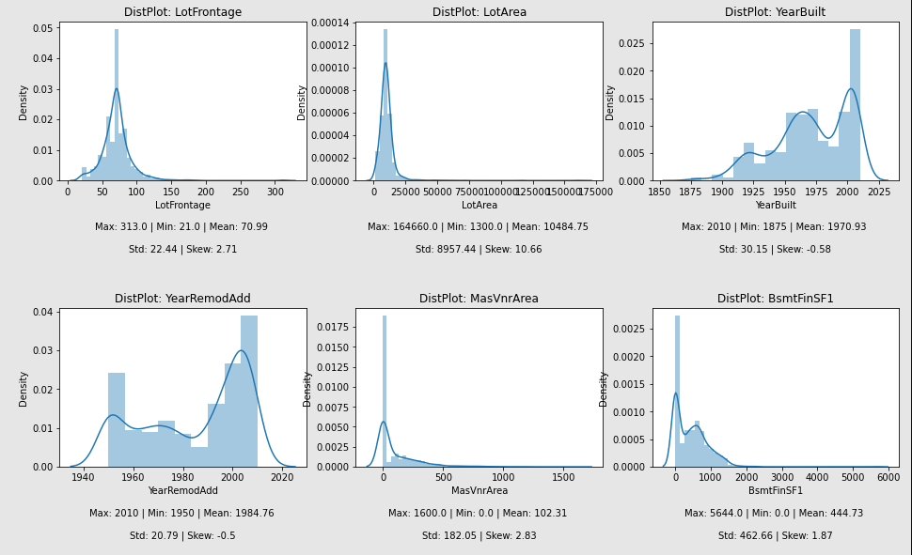
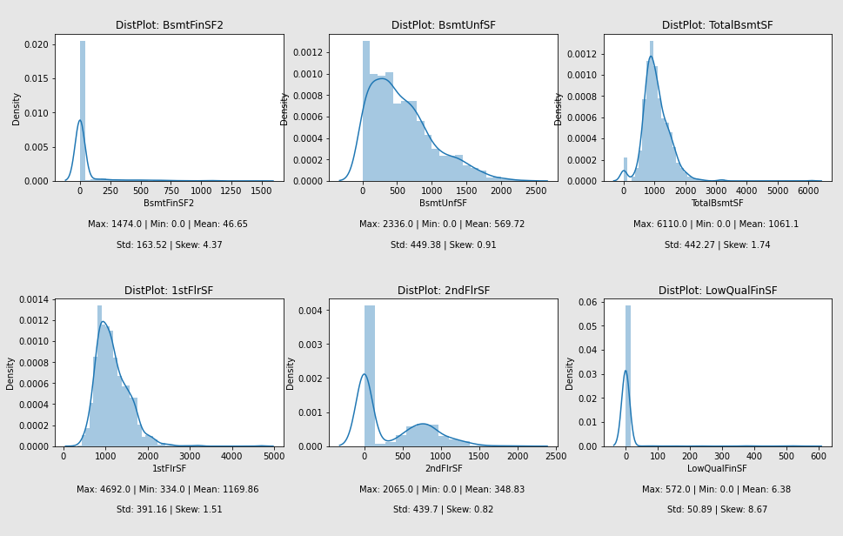
Exploratory Data analysis (eda) & visualization
Univariate Analysis
Univariate analysis is the simplest form of data analysis where the data being analyzed contains only one variable. In this project, distribution plot, count plot, box plot and bar plot has been used.
Distribution Plot:

Slide 13
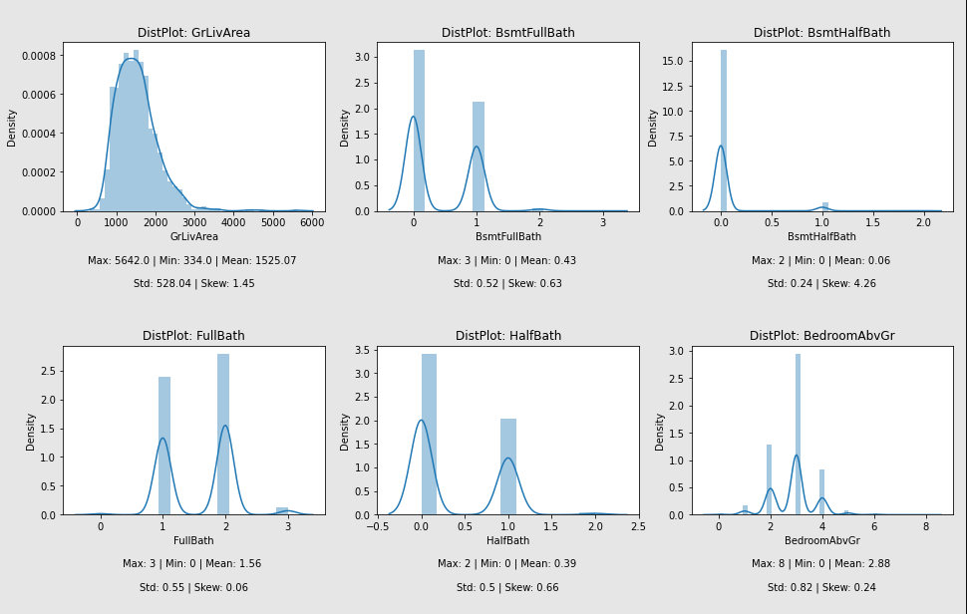
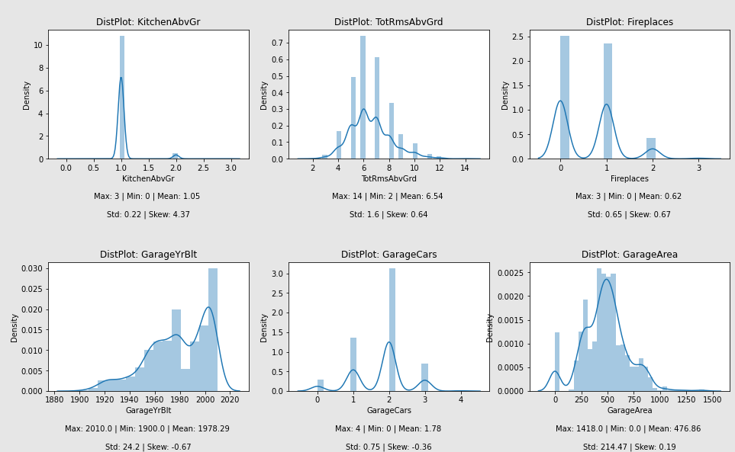
Exploratory Data analysis (eda) & visualization
Univariate Analysis

Slide 14
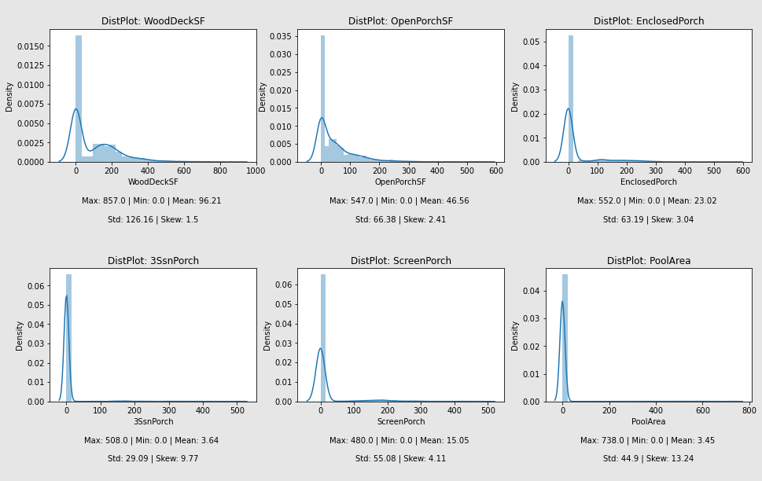
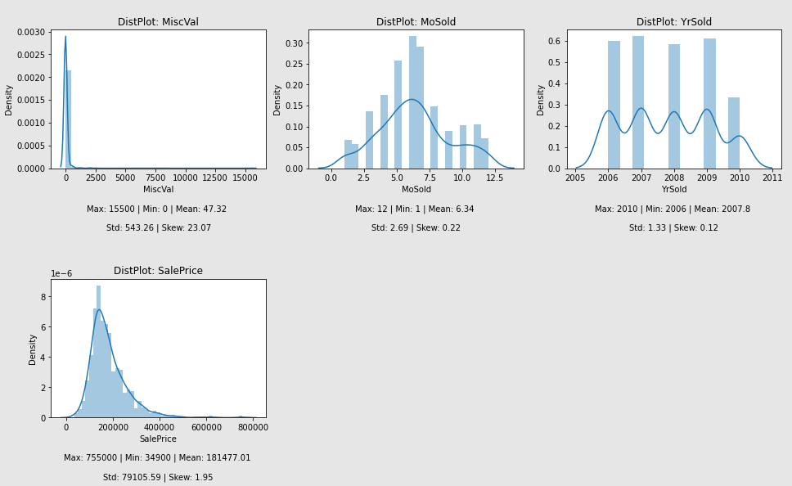
Exploratory Data analysis (eda) & visualization
Univariate Analysis

Slide 15
Exploratory Data analysis (eda) & visualization
Univariate Analysis: Distribution Plot Remarks
for feature LotFrontage:
Data is not distributed normally or in bell curve.
Data ranges from 21 to 313 with mean value 70.99
Data is sort of positively skewed.
for feature LotArea:
Data is not distributed normally or in bell curve.
Data ranges from 1300 to 164660 with mean value 10484.75
Data is highly positively skewed and needs to be treated accordingly.
for feature YearBuilt:
Data is not distributed normally or in bell curve.
Data ranges from 1875 to 2010 with mean value 1971
Data is sort of negatively skewed.
for feature YearRemodAdd:
Data is not distributed normally or in bell curve.
Data ranges from 1950 to 2010 with mean value 1985
Data is sort of negatively skewed.
for feature MassVnrArea:
Data is not distributed normally or in bell curve.
Data ranges from 0 to 1600 with mean value 102.31
Data is sort of positively skewed.
Data is spreaded.

Slide 16
Exploratory Data analysis (eda) & visualization
Univariate Analysis: Distribution Plot Remarks
for feature BsmtFinSF1:
Data is not distributed normally or in bell curve.
Data ranges from 0 to 5644 with mean value 444.73
Data is sort of positively skewed.
Data is spreaded.
for feature BsmtFinSF2:
Data is not distributed normally or in bell curve.
Data ranges from 0 to 1474 with mean value 46.65
Data is sort of positively skewed.
Data is spreaded.
for feature BsmtUnfSF:
Data is not distributed normally or in bell curve.
Data ranges from 0 to 2336 with mean value 569.72
Data is sort of positively skewed.
Data is spreaded.
for feature TotalBsmtSF:
Data is not distributed normally or in bell curve.
Data ranges from 0 to 6110 with mean value 1061.1
Data is sort of positively skewed.
Data is spreaded.
for feature 1stFlrSF:
Data is not distributed normally or in bell curve.
Data ranges from 334 to 4692 with mean value 1169.86
Data is sort of positively skewed.
Data is spreaded.
for feature 2ndFlrSF:
Data is not distributed normally or in bell curve.
Data ranges from 0 to 2065 with mean value 348.83
Data is sort of positively skewed.
Data is spreaded.

Slide 17
Exploratory Data analysis (eda) & visualization
Univariate Analysis: Distribution Plot Remarks
for feature LowQualFinSF:
Data is not distributed normally or in bell curve.
Data ranges from 0 to 572 with mean value 6.38
Data is highly positively skewed and needs to be treated accordingly.
for feature GrLivArea:
Data is not distributed normally or in bell curve.
Data ranges from 334 to 5642 with mean value 1525.07
Data is sort of positively skewed.
Data is spreaded.
for feature BsmtFullBath:
Data is not distributed normally or in bell curve.
Data ranges from 0 to 3 with mean value 0.43
for feature BsmtHalfBath:
Data is not distributed normally or in bell curve.
Data ranges from 0 to 2 with mean value 0.06
Data is positively skewed.
for feature FullBath:
Data is not distributed normally or in bell curve.
Data ranges from 0 to 3 with mean value 1.56
for feature HalfBath:
Data is not distributed normally or in bell curve.
Data ranges from 0 to 2 with mean value 0.39

Slide 18
Exploratory Data analysis (eda) & visualization
Univariate Analysis: Distribution Plot Remarks
for feature BedroomAbvGr:
Data is not distributed normally or in bell curve.
Data ranges from 0 to 8 with mean value 2.88
for feature KitchenAbvGr:
Data is not distributed normally or in bell curve.
Data ranges from 0 to 3 with mean value 1.05
for feature TotRmsAbvGrd:
Data is not distributed normally or in bell curve.
Data ranges from 2 to 14 with mean value 6.54
for feature Fireplaces:
Data is not distributed normally or in bell curve.
Data ranges from 0 to 3 with mean value 0.62
for feature GarageYrBlt:
Data is not distributed normally or in bell curve.
Data ranges from 1900 to 2010 with mean value 1978
for feature GarageCars:
Data is not distributed normally or in bell curve.
Data ranges from 0 to 4 with mean value 1.78

Slide 19
Exploratory Data analysis (eda) & visualization
Univariate Analysis: Distribution Plot Remarks
for feature GarageArea:
Data is not distributed normally or in bell curve.
Data ranges from 0 to 1418 with mean value 776.86
for feature WoodDeckSF:
Data is not distributed normally or in bell curve.
Data ranges from 0 to 857 with mean value 96.21
Data is spreaded.
for feature OpenPorchSF:
Data is not distributed normally or in bell curve.
Data ranges from 0 to 547 with mean value 46.56
Data is spreaded.
for feature EnclosedPorch:
Data is not distributed normally or in bell curve.
Data ranges from 0 to 552 with mean value 23.02
for feature 3SsnPorch:
Data is not distributed normally or in bell curve.
Data ranges from 0 to 508 with mean value 3.64
for feature ScreenPorch:
Data is not distributed normally or in bell curve.
Data ranges from 0 to 480 with mean value 15.05
Data is positively high skewed.

Slide 20
Exploratory Data analysis (eda) & visualization
Univariate Analysis: Distribution Plot Remarks
for feature PoolArea:
Data is not distributed normally or in bell curve.
Data ranges from 0 to 738 with mean value 345
for feature MiscVal:
Data is not distributed normally or in bell curve.
Data ranges from 0 to 15500 with mean value 47.32
Data is positively high skewed.
for feature MoSold:
Data is not distributed normally or in bell curve.
Data ranges from 1 to 12 with mean value 6.34
for feature YrSold:
Data is not distributed normally or in bell curve.
Data ranges from 2006 to 2010 with mean value 2007
for feature SalePrice:
Data is somewhat distributed normally but not in bell curve.
Data ranges from 34900 to 755000 with mean value 181477.01

Slide 21
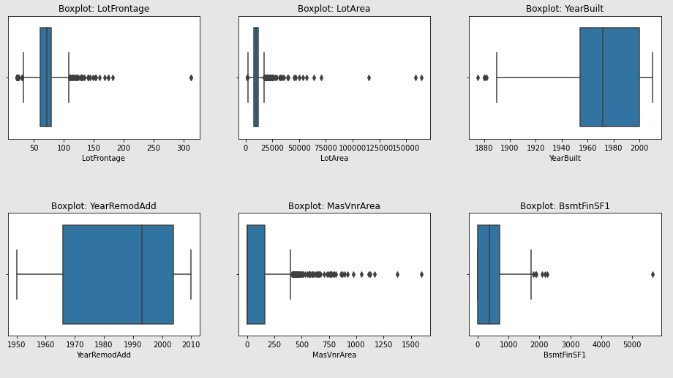
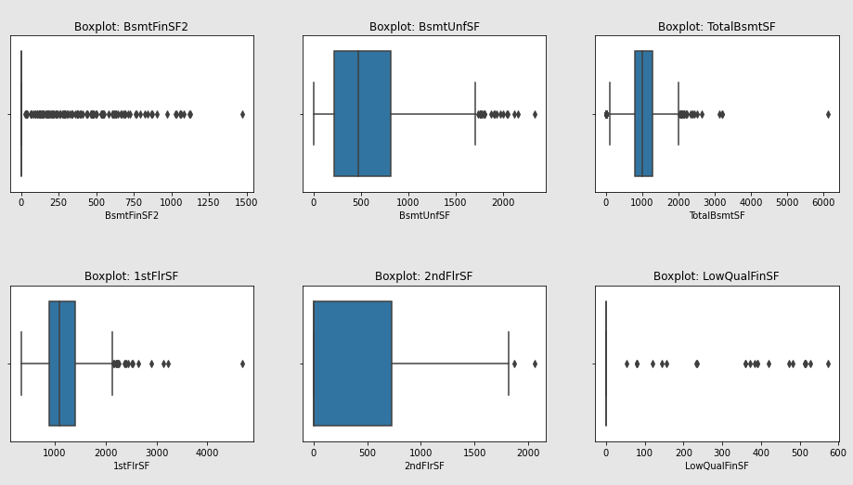
Exploratory Data analysis (eda) & visualization
Univariate Analysis: Box Plot

Slide 22
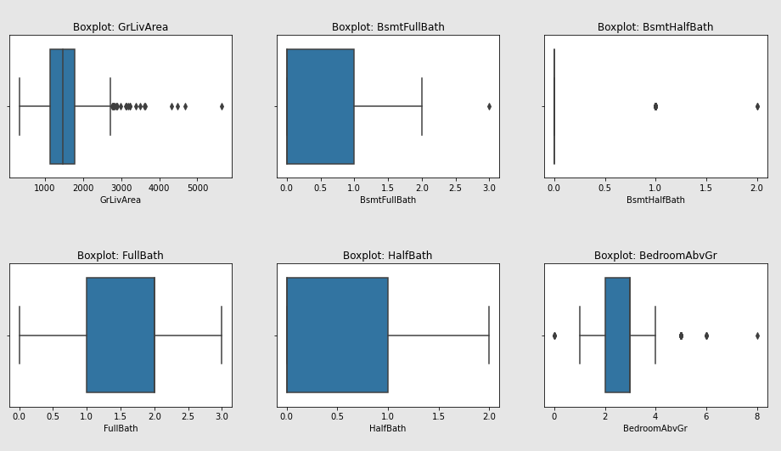
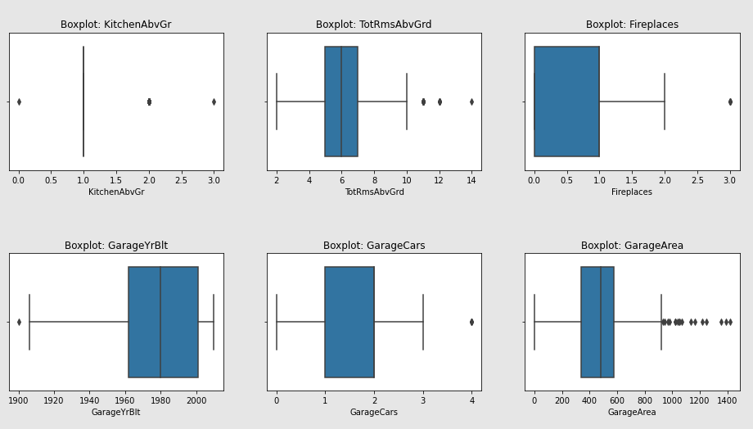
Exploratory Data analysis (eda) & visualization
Univariate Analysis: Box Plot

Slide 23
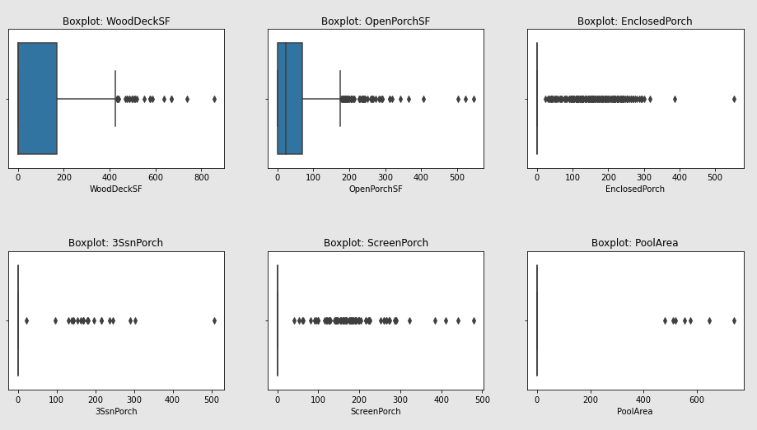
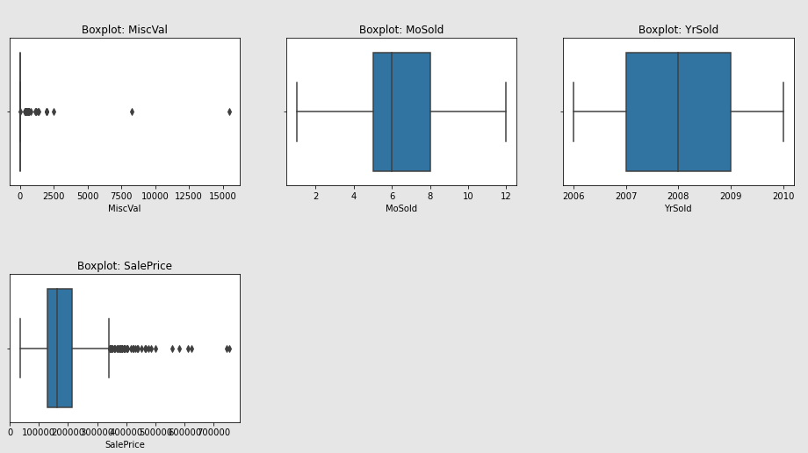
Exploratory Data analysis (eda) & visualization
Univariate Analysis: Box Plot

Slide 24
Exploratory Data analysis (eda) & visualization
Univariate Analysis: Box Plot Remarks
Except features YearBuilt, YearRemodAdd, 2ndFlrSF, BsmtFullBath, BsmtHalfBath, FullBath, HalfBath, BedroomAbvGr, KitchenAbvGr, TotRmsAbvGrd, Fireplaces, GarageYrBlt, GarageCars, MoSold and YrSold, boxplot shows some or more outliers might be present in other features.

Slide 25
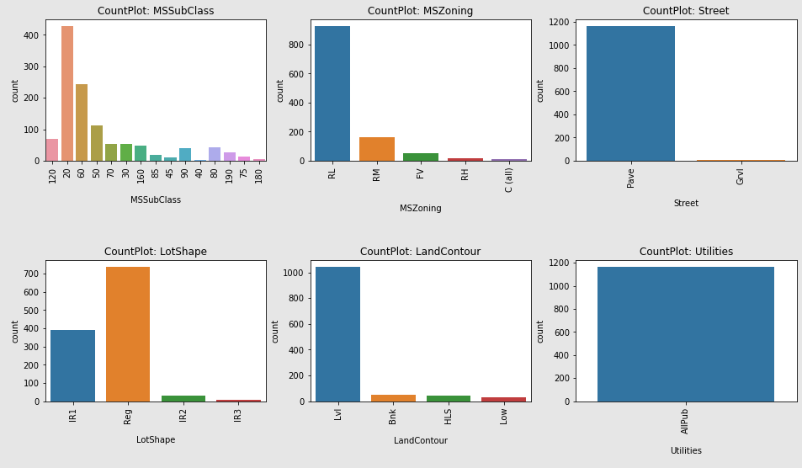
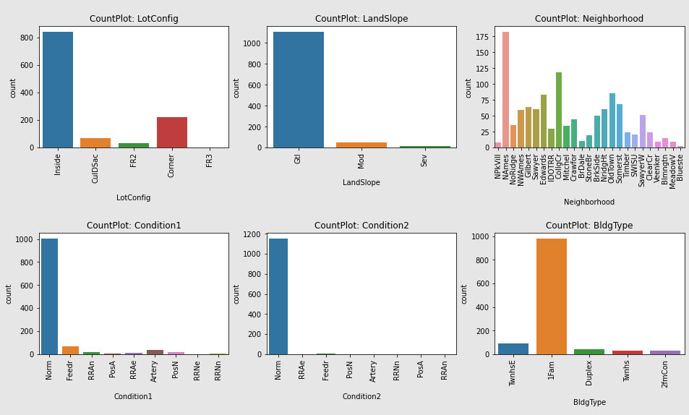
Exploratory Data analysis (eda) & visualization
Univariate Analysis: Count Plot

Slide 26
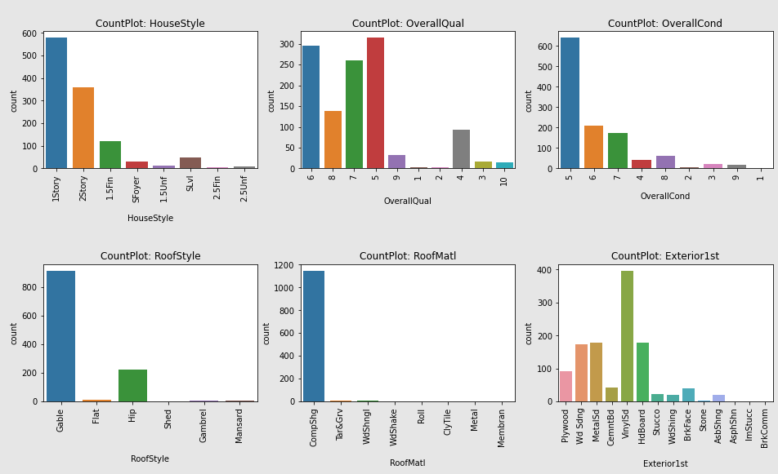
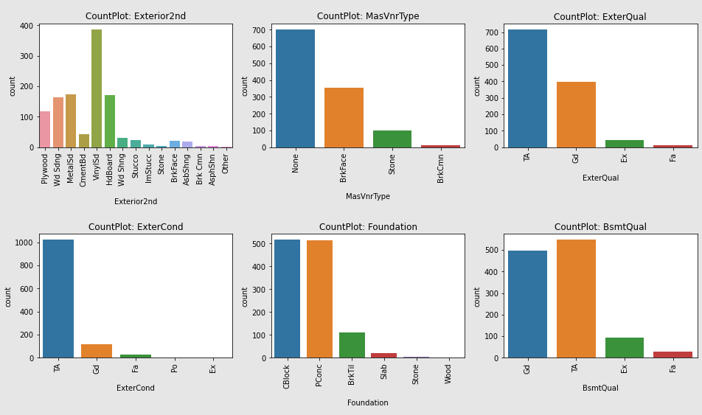
Exploratory Data analysis (eda) & visualization
Univariate Analysis: Count Plot

Slide 27
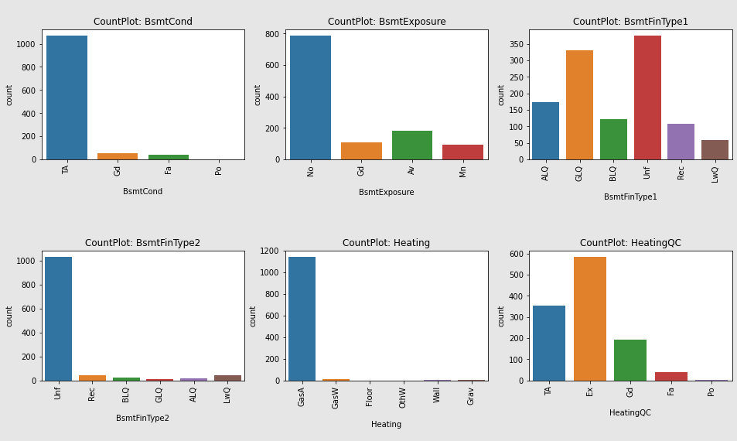
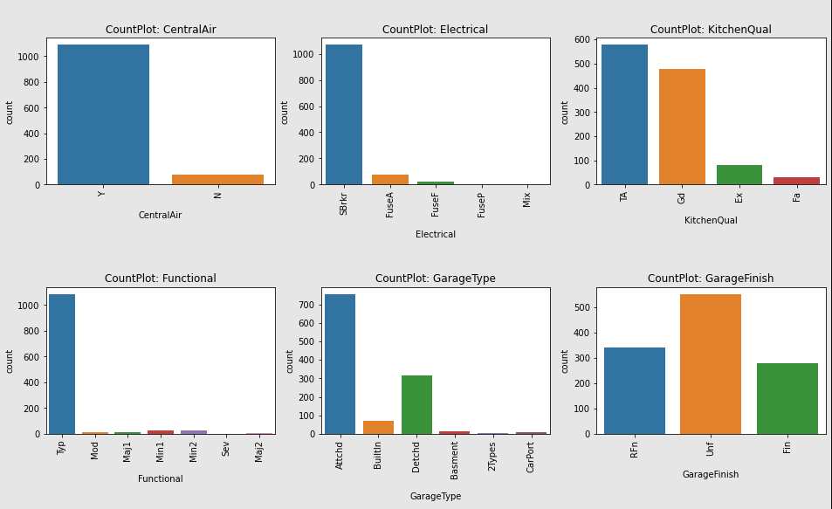
Exploratory Data analysis (eda) & visualization
Univariate Analysis: Count Plot

Slide 28
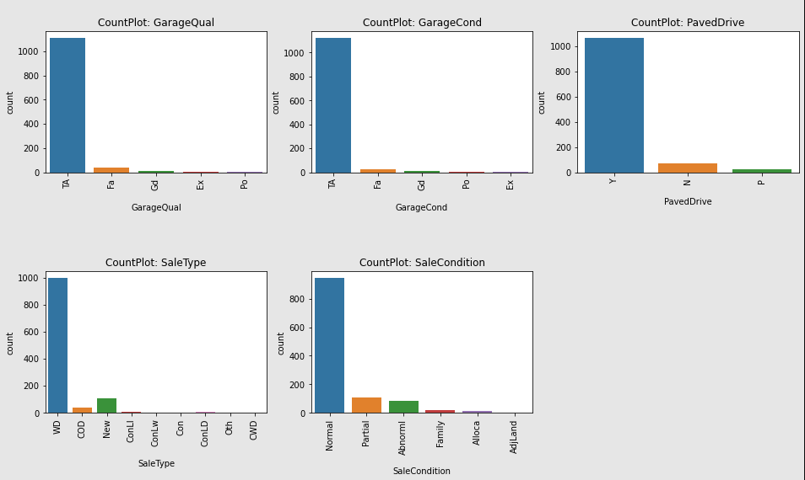
Exploratory Data analysis (eda) & visualization
Univariate Analysis: Count Plot

Slide 29
Exploratory Data analysis (eda) & visualization
Univariate Analysis: Count Plot Remarks
for feature MSSubClass:
Maximum number of records are available for 20.
Minimum number of records are available for 40.
Majority of records are for 20, 60, 50 & 120.
for feature MSZoning:
Maximum number of records are available for RL.
Minimum number of records are available for C(all).
for feature Street:
Maximum number of records are available for Pave.
Minimum number of records are available for Grvl.
for feature LotShape:
Maximum number of records are available for Reg.
Minimum number of records are available for IR3.
Majority of records are for Reg & IR1.
for feature LandContour:
Maximum number of records are available for Lvl.
Minimum number of records are available for Low.
for feature Utilities:
All of the records are for AllPub and hence, this feature can be dropped from the dataset as it is of no use.
for feature LotConfig:
Maximum number of records are available for Inside.
Minimum number of records are available for FR3.
for feature LandSlope:
Maximum number of records are available for Gtl.
Minimum number of records are available for Sev.

Slide 30
Exploratory Data analysis (eda) & visualization
Univariate Analysis: Count Plot Remarks
for feature Neighborhood:
Maximum number of records are available for NAmes.
Minimum number of records are available for Blueste.
Majority of records are for NAmes, CollgCr, OldTown, Edwards, Somerst, Gilbert, Sawyer, NWAmes and NridgHt.
for feature Condition1:
Most of the records are for Norm.
for feature Condition2:
Most of the records are for Norm.
for feature BldgType:
Most of the records are for 1Fam.
for feature HouseStyle:
Most of the records are for 1Story and 2Story.
for feature OverallQual:
Most of the records are for 5, 6, 7, 8, & 4.
for feature OverallCond:
Most of the records are for 5, 6, 7.
for feature RoofStyle:
Most of the records are for Gable.
for feature RoofMatl:
Most of the records are for CompShg.
for feature Exterior1st:
Most of the records are for VinylSd, HdBoard, MetalSd, Wd Sdng & Plywood.
for feature Exterior2nd:
Most of the records are for VinylSd, HdBoard, MetalSd, Wd Sdng & Plywood.
for feature MasVnrType:
Most of the records are for None and BrkFace.
for feature ExterQual:
Most of the records are for TA & Gd.
for feature ExterCond:
Most of the records are for TA.
for feature Foundation:
Most of the records are for CBlock and PConc

Slide 31
Exploratory Data analysis (eda) & visualization
Univariate Analysis: Count Plot Remarks
for feature BsmtQual:
Most of the records are for TA & Gd.
for feature BsmtCond:
Most of the records are for TA.
for feature BsmtExposure:
Most of the records are for No.
for feature BsmtFinType1:
Most of the records are for Unf, GLQ and ALQ.
for feature BsmtFinType2:
Most of the records are for Unf.
for feature Heating:
Most of the records are for GasA.
for feature HeatingQC:
Most of the records are for Ex, TA and Gd.
for feature CentralAir:
Most of the records are for Y.
for feature Electrical:
Most of the records are for SBrkr.
for feature KitchenQual:
Most of the records are for TA & Gd.
for feature Functional:
Most of the records are for Typ.
for feature GarageType:
Most of the records are for Attchd and Detchd.
for feature GarageFinish:
Most of the records are for Unf.
for feature GarageQual:
Most of the records are for TA.

Slide 32
Exploratory Data analysis (eda) & visualization
Univariate Analysis: Count Plot Remarks
for feature GarageCond:
Most of the records are for TA.
for feature PavedDrive:
Most of the records are for Y.
for feature SaleType:
Most of the records are for WD.
for feature SaleCondition:
Most of the records are for Normal.

Slide 33
Exploratory Data analysis (eda) & visualization
Bivariate Analysis
Bivariate analysis is one of the simplest forms of quantitative analysis. It involves the analysis of two variables, for the purpose of determining the empirical relationship between them. We have analysed the data and it’s relationship with target variable using scatter plot and bar plot as shown.

Slide 34
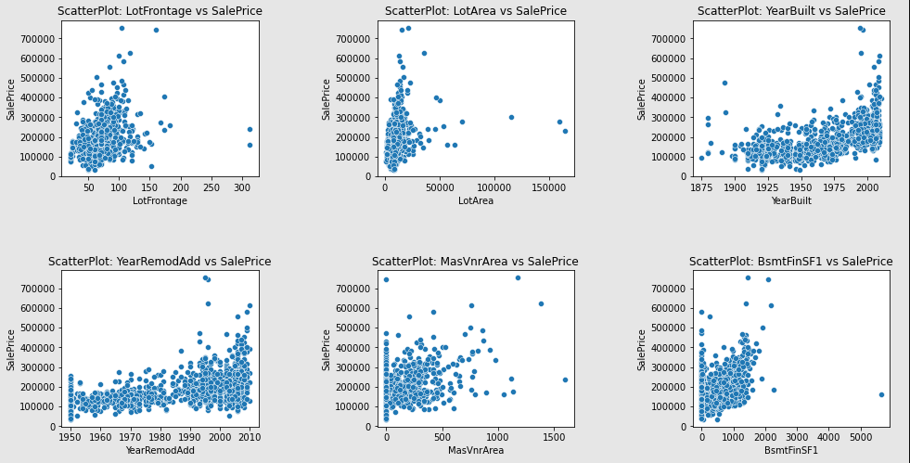
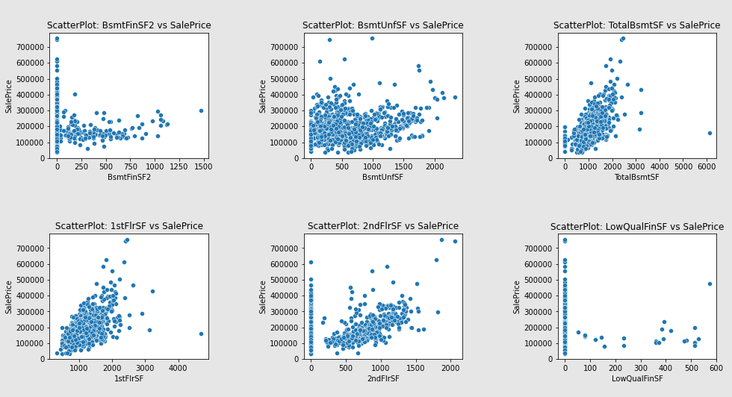
Exploratory Data analysis (eda) & visualization
Bivariate Analysis: Scatter Plot

Slide 35
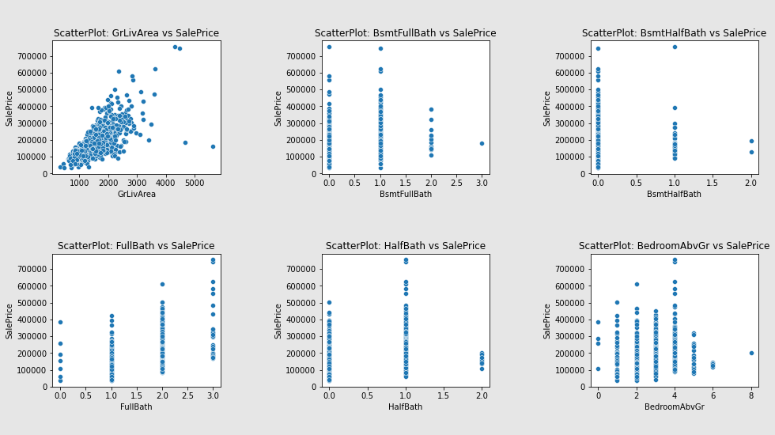
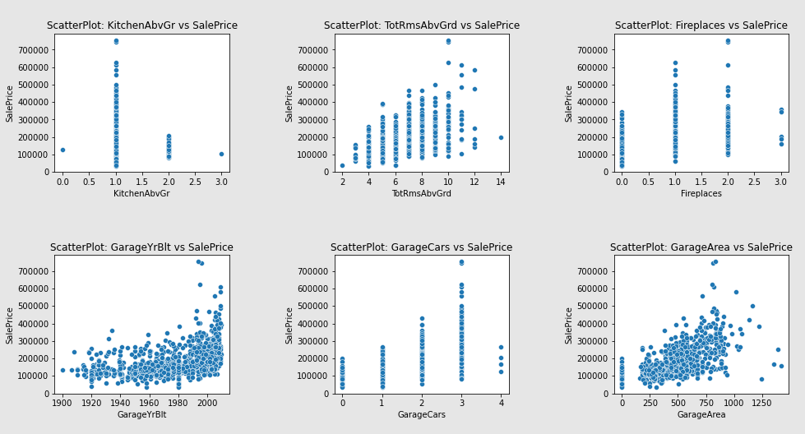
Exploratory Data analysis (eda) & visualization
Bivariate Analysis: Scatter Plot

Slide 36
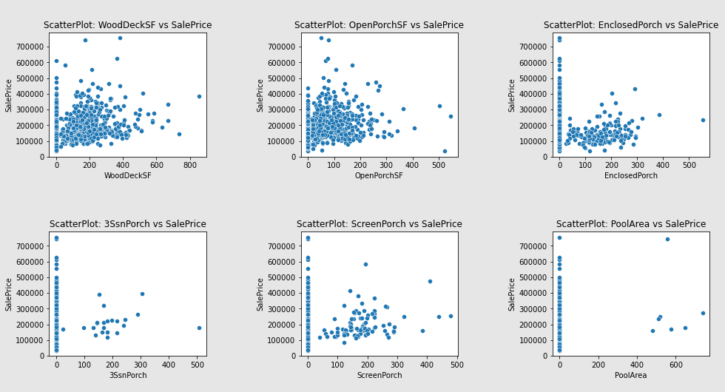
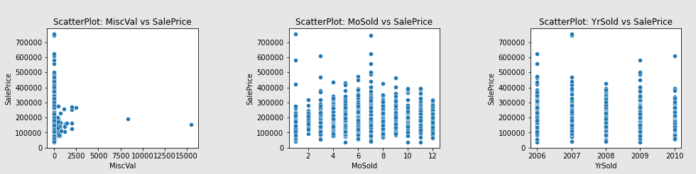
Exploratory Data analysis (eda) & visualization
Bivariate Analysis: Scatter Plot

Slide 37
Exploratory Data analysis (eda) & visualization
Bivariate Analysis: Scatter Plot Remarks
for LotFrontage vs SalePrice:
As the LotFrontage increases SalePrice also increases.
Most of the SalePrice ranges from 100000 to 350000 for LotFrontage between 20 to 110.
for LoatArea vs SalePrice:
As the LotArea increases SalePrice also increases.
Most of the SalePrice ranges from 100000 to 300000 for LotArea between 0 to 20000.
for YearBuilt vs SalePrice:
As the YearBuilt increases SalePrice increases.
Most of the SalePrice ranges from 90000 to 350000 for YearBuilt between 1904 to 2004.
for YearRemodAdd vs SalePrice:
As the YearRemodAdd increases SalePrice increases.
Most of the SalePrice ranges from 100000 to 400000 for YearRemodAdd between 1950 to 2010.
for MasVnrArea vs SalePrice:
As the MasVnrArea increases SalePrice increases.
Most of the SalePrice ranges from 100000 to 400000 for MasVnrArea between 0 to 500.
for BsmtFinSF1 vs SalePrice:
As the BsmtFinSF1 increases SalePrice increases.
Most of the SalePrice ranges from 100000 to 350000 for BsmtFinSF1 between 0 to 1400.

Slide 38
Exploratory Data analysis (eda) & visualization
Bivariate Analysis: Scatter Plot Remarks
for BsmtFinSF2 vs SalePrice:
SalePrice ranges from 100000 to 250000 for BsmtFinSF2 from 0 to 1000.
for BsmtUnfSF vs SalePrice:
SalePrice ranges from 100000 to 300000 for BsmtUnfSF from 0 to 1800.
for TotalBsmtSF vs SalePrice:
SalePrice increases as TotalBsmtSF increases.
Most of SalePrice ranges from 10000 to 450000 for TotalBsmtSF from 0 to 2200.
for 1stFlrSF vs SalePrice:
SalePrice increases as 1stFlrSF increases.
Most of SalePrice ranges from 10000 to 480000 for 1stFlrSF from 400 to 2200.
for 2ndFlrSF vs SalePrice:
SalePrice increases as 2ndFlrSF increases.
Most of SalePrice ranges from 6000 to 350000 for 2ndFlrSF from 300 to 1400.
for LowQualFinSF vs SalePrice:
Most of the SalePrice ranges from 0 to 610000 for LowQualFinSF 0.
for GrLivArea vs SalePrice:
SalePrice increases as GrLivArea increases.
Most of SalePrice ranges from 10000 to 400000 for GrLivArea from 600 to 3000.
for BsmtFullBath vs SalePrice:
SalePrice ranges from 10000 to 410000 for BsmtFullBath 0.
SalePrice ranges from 10000 to 500000 for BsmtFullBath 1.
SalePrice ranges from 100000 to 300000 for BsmtFullBath 2.

Slide 39
Exploratory Data analysis (eda) & visualization
Bivariate Analysis: Scatter Plot Remarks
for BsmtHalfBath vs SalePrice:
SalePrice ranges from 10000 to 610000 for BsmtHalfBath 0.
SalePrice ranges from 100000 to 300000 for BsmtHalfBath 1.
SalePrice ranges from 100000 to 200000 for BsmtHalfBath 2.
for FullBath vs SalePrice:
SalePrice ranges from 10000 to 250000 for FullBath 0.
SalePrice ranges from 10000 to 410000 for FullBath 1.
SalePrice ranges from 100000 to 500000 for FullBath 2.
SalePrice ranges from 190000 to 600000 for FullBath 3.
for HalfBath vs SalePrice:
SalePrice ranges from 10000 to 500000 for HalfBath 0.
SalePrice ranges from 100000 to 600000 for HalfBath 1.
SalePrice ranges from 100000 to 200000 for HalfBath 2.
for BedroomAbvGr vs SalePrice:
SalePrice ranges from 100000 to 390000 for BedroomAbvGr 0.
SalePrice ranges from 10000 to 410000 for BedroomAbvGr 1.
SalePrice ranges from 10000 to 450000 for BedroomAbvGr 2.
SalePrice ranges from 10000 to 430000 for BedroomAbvGr 3.
SalePrice ranges from 80000 to 610000 for BedroomAbvGr 4.
SalePrice ranges from 70000 to 250000 for BedroomAbvGr 5.
SalePrice ranges from 100000 to 130000 for BedroomAbvGr 6.
SalePrice for BedroomAbvGr 8 is 200000.
for KitchenAbvGr vs SalePrice:
SalePrice for KitchenAbvGr 0 is aprox. 120000.
SalePrice ranges from 10000 to 620000 for KitchenAbvGr 1.
SalePrice ranges from 90000 to 210000 for KitchenAbvGr 2.
SalePrice for KitchenAbvGr 3 is aprox. 90000.
for TotRmsAbvGrd vs SalePrice:
SalePrice increases as TotRmsAbvGrd increases.
Most of SalePrice ranges from 10000 to 400000 for TotRmsAbvGrd 4 to 12.

Slide 40
Exploratory Data analysis (eda) & visualization
Bivariate Analysis: Scatter Plot Remarks
for Fireplaces vs SalePrice:
SalePrice ranges from 10000 to 350000 for Fireplaces 0.
SalePrice ranges from 20000 to 600000 for Fireplaces 1.
SalePrice ranges from 80000 to 500000 for Fireplaces 2.
SalePrice ranges from 180000 to 350000 for Fireplaces 3.
for GarageYrBlt vs SalePrice:
SalePrice increases as GarageYrBlt increases.
Most of SalePrice ranges from 80000 to 400000 for GarageYrBlt 1920 to 2010.
for GarageCars vs SalePrice:
SalePrice ranges from 10000 to 200000 for GarageCars 0.
SalePrice ranges from 10000 to 280000 for GarageCars 1.
SalePrice ranges from 20000 to 420000 for GarageCars 2.
SalePrice ranges from 50000 to 650000 for GarageCars 3.
SalePrice ranges from 110000 to 300000 for GarageCars 4.
for GarageArea vs SalePrice:
SalePrice increases as GarageArea increases.
Most of SalePrice ranges from 50000 to 500000 for GarageArea 240 to 900.
for WoodDeckSF vs SalePrice:
SalePrice increases as WoodDeckSF increases.
Most of SalePrice ranges from 80000 to 400000 for WoodDeckSF 0 to 400.
for OpenPorchSF vs SalePrice:
SalePrice increases as OpenPorchSF increases.
Most of SalePrice ranges from 100000 to 400000 for OpenPorchSF 0 to 250.
for EnclosedPorch vs SalePrice:
SalePrice increases as EnclosedPorch increases.
Most of SalePrice ranges from 90000 to 200000 for EnclosedPorch 10 to 300.

Slide 41
Exploratory Data analysis (eda) & visualization
Bivariate Analysis: Scatter Plot Remarks
for 3SsnPorch vs SalePrice:
Most of the SalePrice ranges from 10000 to 620000 for 3SsnPorch 0.
SalePrice ranges from 100000 to 400000 for 3SsnPorch 100 to 300.
for ScreenPorch vs SalePrice:
Most of the SalePrice ranges from 10000 to 620000 for ScreenPorch 0.
SalePrice ranges from 100000 to 400000 for ScreenPorch 50 to 300.
for PoolArea vs SalePrice:
Most of the SalePrice ranges from 10000 to 620000 for PoolArea 0.
SalePrice ranges from 150000 to 300000 for PoolArea 450 to 800.
for MiscVal vs SalePrice:
Most of the SalePrice ranges from 10000 to 620000 for MiscVal 0.
SalePrice ranges from 50000 to 280000 for MiscVal 500 to 2500.
for MoSold vs SalePrice:
Most of the SalePrice ranges from 10000 to 280000 for MoSold 1.
Most of the SalePrice ranges from 80000 to 310000 for MoSold 2.
Most of the SalePrice ranges from 30000 to 350000 for MoSold 3.
Most of the SalePrice ranges from 60000 to 350000 for MoSold 4.
Most of the SalePrice ranges from 10000 to 410000 for MoSold 5.
Most of the SalePrice ranges from 30000 to 450000 for MoSold 6.
Most of the SalePrice ranges from 20000 to 600000 for MoSold 7.
Most of the SalePrice ranges from 50000 to 350000 for MoSold 8.
Most of the SalePrice ranges from 60000 to 400000 for MoSold 9.
Most of the SalePrice ranges from 30000 to 380000 for MoSold 10.
Most of the SalePrice ranges from 10000 to 380000 for MoSold 11.
Most of the SalePrice ranges from 40000 to 310000 for MoSold 12.

Slide 42
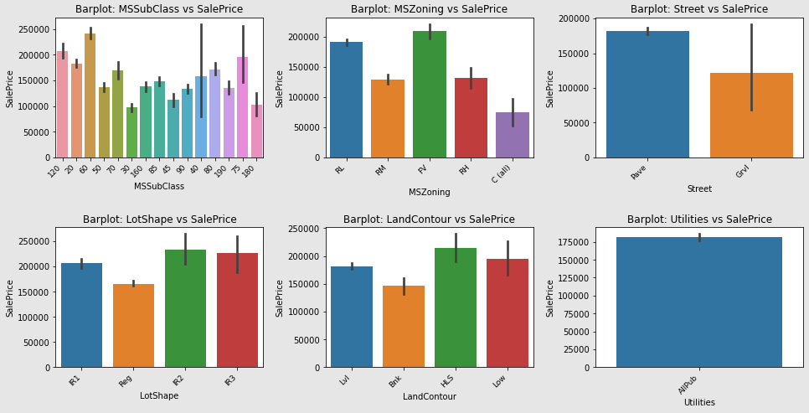
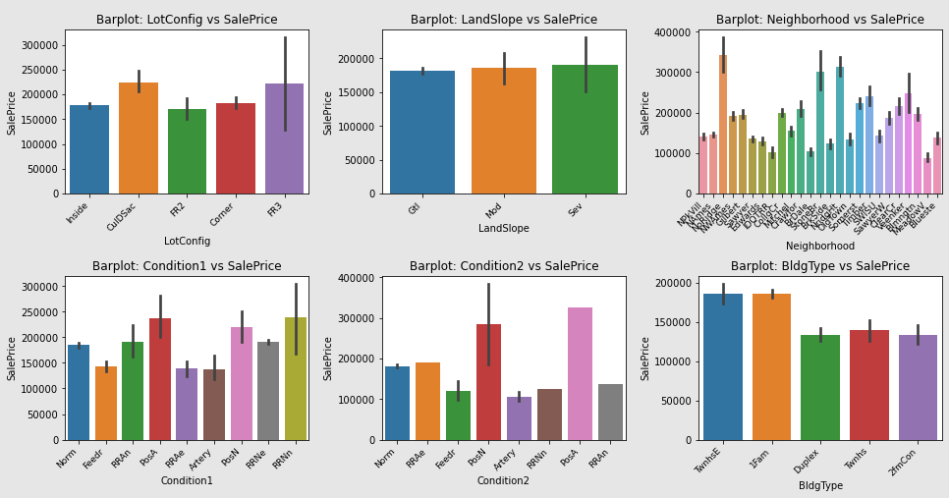
Exploratory Data analysis (eda) & visualization
Bivariate Analysis: Bar Plot

Slide 43
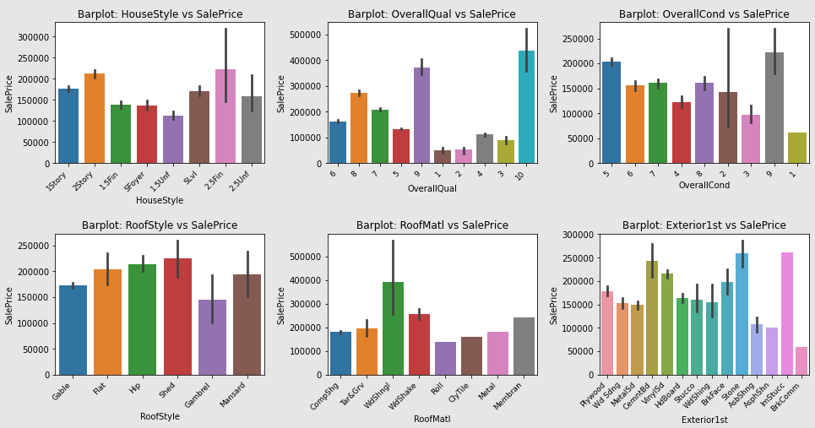
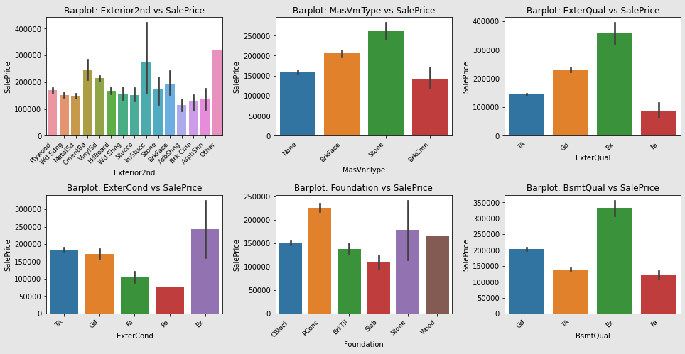
Exploratory Data analysis (eda) & visualization
Bivariate Analysis: Bar Plot

Slide 44
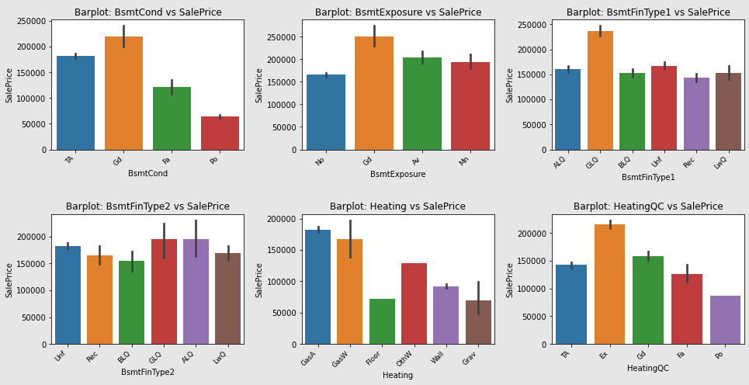
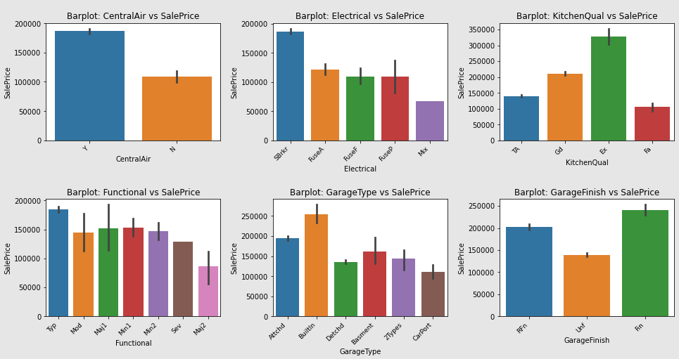
Exploratory Data analysis (eda) & visualization
Bivariate Analysis: Bar Plot

Slide 45
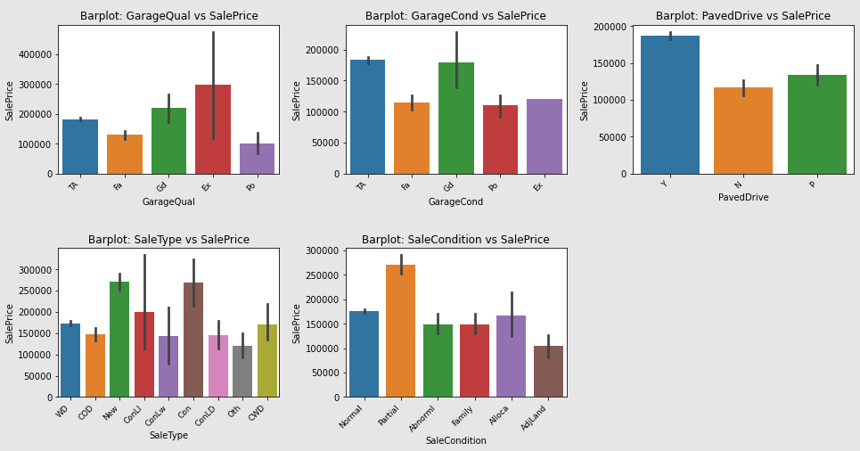
Exploratory Data analysis (eda) & visualization
Bivariate Analysis: Bar Plot

Slide 46
Exploratory Data analysis (eda) & visualization
Bivariate Analysis: Bar Plot Remarks
for feature MSSubClass vs SalePrice:
MSSubClass with 60 has highest SalePrice while with 30 has lowest SalePrice.
for feature MSZoning vs SalePrice:
MSZoning with FV has highest SalePrice while with C(all) has lowest SalePrice.
for feature Street vs SalePrice:
Street with Pave has highest SalePrice while with Grvl has lowest SalePrice.
for feature LotShape vs SalePrice:
LotShape with R2 and R3 has highest SalePrice while with Reg has lowest SalePrice.
for feature LandContour vs SalePrice:
LandContour with HLS has highest SalePrice while with Bnk has lowest SalePrice.
for feature Utilities vs SalePrice:
Utilities has a single AllPub, therefore, it can be dropped from dataset as it is of no use.
for feature LotConfig vs SalePrice:
LotConfig with CulDSac and FR3 has highest SalePrice while with FR2 has lowest SalePrice.

Slide 47
Exploratory Data analysis (eda) & visualization
Bivariate Analysis: Bar Plot Remarks
for feature LandSlope vs SalePrice:
LandSlope with Sev, Mod and Gtl has almost similar SalePrice.
for feature Neighborhood vs SalePrice:
Neighborhood with NoRidge, NodgHt and StoneBr has highest SalePrice while with MeadowV has lowest SalePrice.
for feature Condition1 vs SalePrice:
Condition1 with PosA and RRNn has highest SalePrice while with RRAe and Artery has lowest SalePrice.
for feature Condition2 vs SalePrice:
Condition2 with PosA has highest SalePrice while with Artery, Feedr and RRNn has lowest SalePrice.
for feature BldgType vs SalePrice:
BldgType with TwnhsE and 1Fam has highest SalePrice while with Duplex, Twnhs and 2fmCon has lowest SalePrice.
for feature HouseStyle vs SalePrice:
HouseStyle with 2.5Fin and 2Story has highest SalePrice while with 1.5Unf has lowest SalePrice.
for feature OverallQual vs SalePrice:
OverallQual with 10 and 9 has highest SalePrice while with 1 and 2 has lowest SalePrice.

Slide 48
Exploratory Data analysis (eda) & visualization
Bivariate Analysis: Bar Plot Remarks
for feature OverallQual vs SalePrice:
OverallQual with 10 and 9 has highest SalePrice while with 1 and 2 has lowest SalePrice.
for feature OverallCond vs SalePrice:
LotConfig with 9 and 5 has highest SalePrice while with 1 has lowest SalePrice.
for feature RoofStyle vs SalePrice:
RoofStyle with Shed and Hip has highest SalePrice while with Gambrel has lowest SalePrice.
for feature RoofMatl vs SalePrice:
RoofMatl with WdShngl has highest SalePrice while with Roll has lowest SalePrice.
for feature Exterior1st vs SalePrice:
Exterior1st with Stone, lmStucc and CemntBd has highest SalePrice while with BrkComm has lowest SalePrice.
for feature Exterior2nd vs SalePrice:
Exterior2nd with Other and lmStucc has highest SalePrice while with AsbShng has lowest SalePrice.
for feature MasVnrType vs SalePrice:
MasVnrType with Stone has highest SalePrice while with BrkCmn has lowest SalePrice.
for feature ExterQual vs SalePrice:
ExterQual with Ex has highest SalePrice while with Fa has lowest SalePrice.
for feature ExterCond vs SalePrice:
ExterCond with Ex has highest SalePrice while with Po has lowest SalePrice.

Slide 49
Exploratory Data analysis (eda) & visualization
Bivariate Analysis: Bar Plot Remarks
for feature Foundation vs SalePrice:
Foundation with PConc has highest SalePrice while with Slab has lowest SalePrice.
for feature BsmtQual vs SalePrice:
Bsmt with Ex has highest SalePrice while with Fa and TA has lowest SalePrice.
for feature BsmtCond vs SalePrice:
BsmtCond with Gd has highest SalePrice while with Po has lowest SalePrice.
for feature BsmtExposure vs SalePrice:
BsmtExposure with Gd has highest SalePrice while with No has lowest SalePrice.
for feature BsmtFinType1 vs SalePrice:
BsmtFinType1 with GLQ has highest SalePrice while with Rec, BLQ, Unf, LwQ and ALQ has lowest SalePrice but almost similer SalePrice.
for feature BsmtFinType2 vs SalePrice:
BsmtFinType2 with GLQ and ALQ has highest SalePrice while with BLQ has lowest SalePrice.
for feature Heating vs SalePrice:
Heating with GasA has highest SalePrice while with Floor has lowest SalePrice.

Slide 50
Exploratory Data analysis (eda) & visualization
Bivariate Analysis: Bar Plot Remarks
for feature HeatingQC vs SalePrice:
HeatingQC with Ex has highest SalePrice while with Po has lowest SalePrice.
for feature CentralAir vs SalePrice:
CentralAir with Y has highest SalePrice while with N has lowest SalePrice.
for feature Electrical vs SalePrice:
Electrical with SBrkr has highest SalePrice while with Mix has lowest SalePrice.
for feature KitchenQual vs SalePrice:
KitchenQual with Ex has highest SalePrice while with Fa has lowest SalePrice.
for feature LotConfig vs SalePrice:
LotConfig with CulDSac and FR3 has highest SalePrice while with FR2 has lowest SalePrice.
for feature Functional vs SalePrice:
Functional with Typ has highest SalePrice while with Maj2 has lowest SalePrice.
for feature GarageType vs SalePrice:
GarageType with BuiltIn has highest SalePrice while with CarPort has lowest SalePrice.
for feature GarageFinish vs SalePrice:
GarageFinish with Fin has highest SalePrice while with Unf has lowest SalePrice.
for feature GarageQual vs SalePrice:
GarageQual with Ex has highest SalePrice while with Po has lowest SalePrice.
for feature GarageCond vs SalePrice:
GarageCond with Gd and TA has highest SalePrice while with Po and Fa has lowest SalePrice.

Slide 51
Exploratory Data analysis (eda) & visualization
Bivariate Analysis: Bar Plot Remarks
for feature PavedDrive vs SalePrice:
PavedDrive with Y has highest SalePrice while with N has lowest SalePrice.
for feature SaleType vs SalePrice:
SaleType with New and Con has highest SalePrice while with COD, ConLw, ConLD and Oth has lowest SalePrice.
for feature SaleCondition vs SalePrice:
SaleCondition with Partial has highest SalePrice while with AdjLand has lowest SalePrice.
for feature LotConfig vs SalePrice:
LotConfig with CulDSac and FR3 has highest SalePrice while with FR2 has lowest SalePrice.

Slide 52
Exploratory Data analysis (eda) & visualization
Multivariate Analysis
Multivariate analysis is based on the principles of multivariate statistics, which involves observation and analysis of more than one statistical outcome variable at a time.
Heatmap is being used to represent the correlation of features from a scale of -1.0 to 1.0. After going through heatmap it is found that Features GrLivArea, TotalBsmtSF, 1stFlrSF, 2ndFlrSF, FullBath, GarageCars, GarageArea, YearBuilt, YearRemodAdd, MasVnrArea, TotRmsAbvGrd, FirePlaces, GarageYrBlt are positively high correlated to target SalePrice while features like BsmtFinSF1, LotFrontage, 2ndFlrSF, HalfBath, WoodDeckSF, OpenPorchSF are positively good correlated to SalePrice.

Slide 53
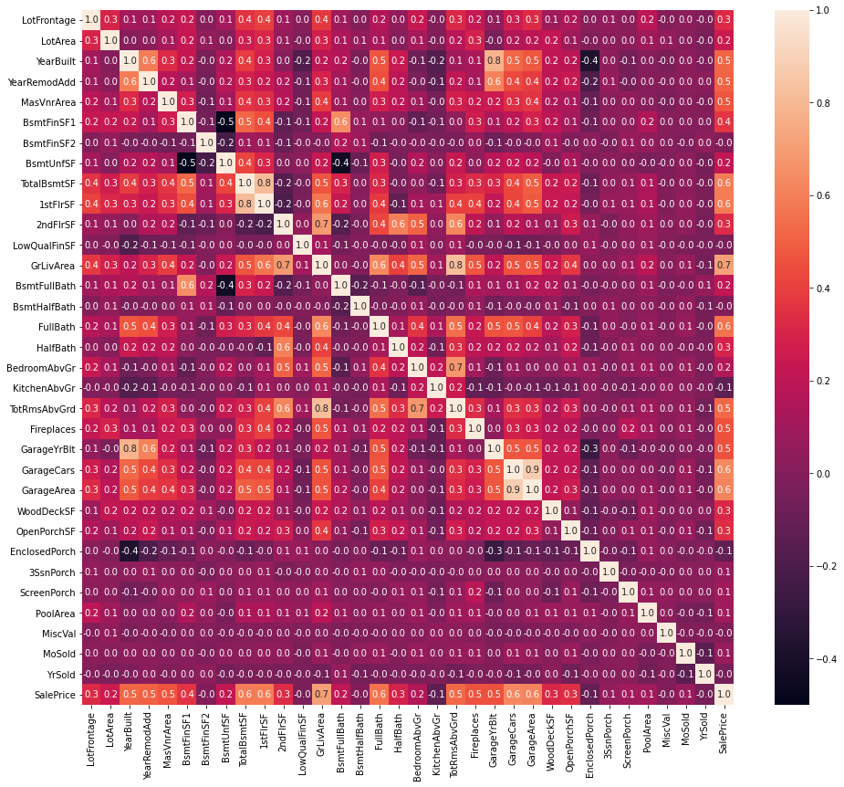
Exploratory Data analysis (eda) & visualization
Multivariate Analysis

Slide 54
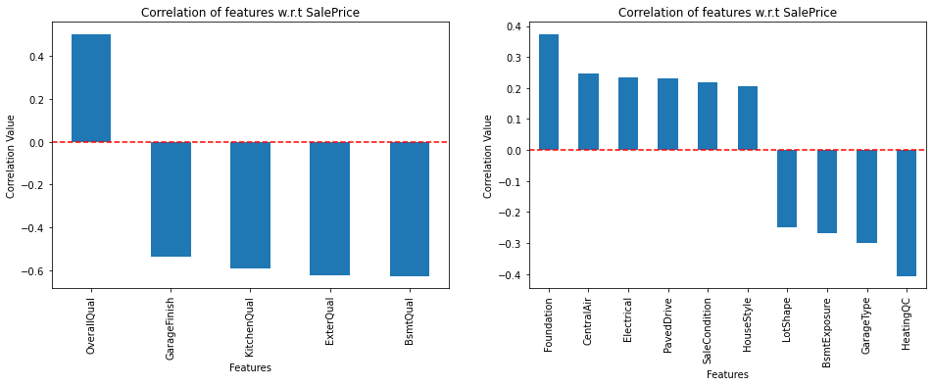
Exploratory Data analysis (eda) & visualization
Multivariate Analysis
Features OverallQual has positively high correlation with SalePrice while features BmstQual, ExterQual, KitchenQual, GarageFinish has negatively high correlation with SalePrice.
Features Foundation, CentralAir, Electrical, PavedDrive, SaleCondition, HouseStyle has positively good correlation with SalePrice while features HeatingQC, GarageType, BsmtExposure, LotShape has negatively good correlation with SalePrice.
All other features has low correlation with SalePrice

Slide 55
Exploratory Data analysis (eda) & visualization
Concluding Remarks
Starting with univariate analysis, with help of distplot we found that data in all continuous features are not distributted normally and needs to be scaled before sending for model training. Moving further, we also found that data in most of the features are skewed and spreaded, therefore, this needs to be treated before model training. Also, it is observed that except features YearBuilt, YearRemodAdd, 2ndFlrSF, BsmtFullBath, BsmtHalfBath, FullBath, HalfBath, BedroomAbvGr, KitchenAbvGr, TotRmsAbvGrd, Fireplaces, GarageYrBlt, GarageCars, MoSold and YrSold, boxplot shows some or more outliers might be present in other features. Further analysing the categorical features using countplot, it is observed that feature Utilities has a single value for all records, therefore, it needs to be dropped because of no use in model training. After the we came up with bivariate analysis which gives the close look of relationship between features and target variable SalePrice. Using scatterplot for continuous features, it is observed that SalePrice increases with the increase in feature LotFrontage, LotArea, YearBuilt, YearRemodAdd, MasVnrArea, BsmtFinSF1, TotalBsmtSF, 1stFlrSF, LowQualFinSF, GrLivArea, TotRmsAbvGrd, GarageYrBlt, GarageArea, WoodDeckSF, OpenPorchSF and MiscVal. Also, with the help of barplot, it is observed that each feature has value which contributes to the hike in SalePrice as well as reduced the SalePrice. Moving further with multi-variate analysis of continuous features, it is observed that features GrLivArea, TotalBsmtSF, 1stFlrSF, 2ndFlrSF, FullBath, GarageCars, GarageArea, YearBuilt, YearRemodAdd, MasVnrArea, TotRmsAbvGrd, FirePlaces, GarageYrBlt are positively high correlated to target SalePrice while features like BsmtFinSF1, LotFrontage, 2ndFlrSF, HalfBath, WoodDeckSF, OpenPorchSF are positively good correlated to SalePrice. Also, for categorical features, it is observed that OverallQual has positively high correlation with SalePrice while features BmstQual, ExterQual, KitchenQual, GarageFinish has negatively high correlation with SalePrice and features Foundation, CentralAir, Electrical, PavedDrive, SaleCondition, HouseStyle has positively good correlation with SalePrice while features HeatingQC, GarageType, BsmtExposure, LotShape has negatively good correlation with SalePrice. All other features has low or no correlation with SalePrice. The final shape of dataset is 1168 rows and 74 columns.

Slide 56
Model/s Development and Evaluation
Identification of possible problem-solving approaches (methods)
To solve this problem following steps are used:
Load Dataset using pandas
Check of datatypes and correct them as per requirements.
Check for any null or irrelevant values and treat them accordingly.
Check the statistical summary for mean, minimum, maximum, median, standard deviation, skewness etc.
Remove outliers considering max allowed data loss 5-7%.
Scale the data for model training
Train & Test the model.

Slide 57
Model/s Development and Evaluation
Testing of Identified Approaches (Algorithms)
Following are the list of algorithms used for training and testing:
SGDClassifier
GaussianNB
RidgeClassifier
LogisticRegression
AdaBoostClassifier

Slide 58
Model/s Development and Evaluation
Run and Evaluate selected models
A total of 4 algorithm has been used on this dataset for training testing purpose, these are LinearRegression, Lasso, Ridge and AdaBoostRegressor. From the above model performance comparison it is clear that AdaBoostRegressor out-performs the other models with r2_score of 80.83% and lowest difference between r2_score and cross_val_score. Therefore, continuing with AdaBoostRegressor as final model.
S.No. | Name | initial_r2_score | final_r2_score | cross_val_score | Difference(final_r2_score-cross_val_score) | build_time(in seconds)
0 | LinearRegression | 0.835204 | 0.820169 | 0.720565 | 0.099603 | 3.657814
1 | Lasso | 0.835322 | 0.821105 | 0.721745 | 0.099360 | 26.300997
2 | Ridge | 0.837654 | 0.826868 | 0.722859 | 0.104009 | 99.200210
3 | AdaBoostRegressor | 0.812375 | 0.808377 | 0.775261 | 0.033116 | 77.114541

Slide 59
Conclusion
Key Findings and Conclusions of the Study
From the model performance comparison it is clear that AdaBoostRegressor out-performs the other models with r2_score of 80.83% and lowest difference between r2_score and cross_val_score. Therefore, continuing with AdaBoostRegressor as final model.

Slide 60
Conclusion
Learning Outcomes of the Study in respect of Data Science
During the data analysis, some feature contains null values which I have replaced them with median. But these values can also be replaced with the mean of the feature which might impact the model performance either in positive or negative way. As of now, I am finishing this project with my current approach which gives the final accuracy score of 80.83% and cross_val_score: 77.53% and this can be further improved by training with more specific data.

Slide 61
Conclusion
Limitations of this work and Scope for Future Work
Current model is limited to housing prediction data but this can further be improved for other sectors of property price prediction by training the model accordingly. The overall score can also be improved further by training the model with more specific data.

